Slide 1
CUSTOMER SATISFACTION

Slide 2
CUSTOMER SATISFACTION
The most important asset of any organization is its customers
Satisfied customers pay their bills promptly which greatly improves cash flow – the lifeblood of any organization

Slide 3
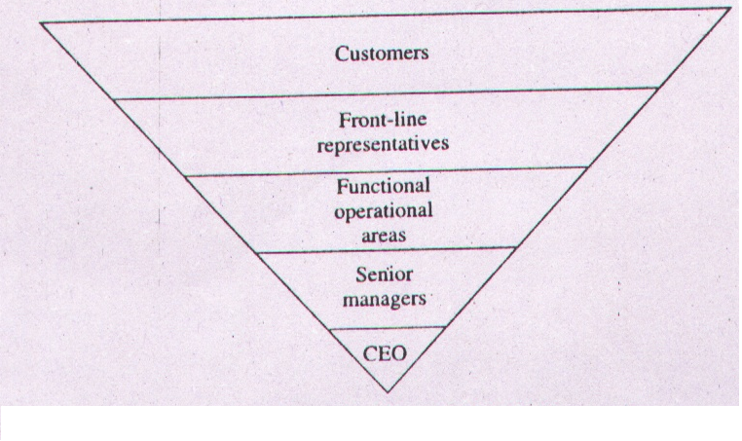
ORGANIZATIONAL HIERARCHIAL DIAGRAM

Slide 4
CUSTOMER SATISFACTION
CUSTOMERS EXPERIENCE OF A PRODUCT OR A SERVICE IS MULTIFACETED SO HARD TO DETERMINE
IT NEEDS TO BE MEASURED INDIVIDUALLY TO GET AN ACCURATE TOTAL PICTURE OF CUSTOMER SATISFACTION

Slide 5
CUSTOMER SATISFACTION
Customer satisfaction should not be viewed in a vacuum.
For example, a customer may be satisfied with a product or service and therefore rate the product or service highly in a survey and yet same customer may buy another product.

Slide 6
CUSTOMER SATISFACTION
Similarly customer’s view about a product or service are useless if customer’s view about competitors products are not understood.

Slide 7
CUSTOMER SATISFACTION
The value customers places on the product compared to another may be a better indication of customer loyalty.

Slide 8
TYPES OF CUSTOMER
External Customer
Internal Customer

Slide 9
CUSTOMER PERCEPTION OF QUALITY
ASQ SURVEY SHOWS THAT IMPORTANT FACTORS THAT INFLUENCE PURCHASING ARE
PERFORMANCE
FEATURES
SERVICE
WARRANTY
PRICE
REPUTATION

Slide 10
FEEDBACK
Comment Card.
Customer Questionnaire.
Focus Groups.
Toll Free Telephone No.
Customer Visits.
Report Card.
Internet & Computer.
Employee Feedback.
Customer complaints

Slide 11
COMMENT CARD
COMMENT CARD CAN BE ATTACHED TO THE WARRANTY CARD & INCLUDED WITH THE PRODUCT AT THE TIME OF THE PURCHASE
INTENT OF THIS CARD IS TO GET SIMPLE INFORMATION SUCH AS NAME , AGE, ADDRESS, OCCUPATION & WHAT MADE THE CUSTOMER BUY THAT PRODUCT

Slide 12
COMMENT CARD
FOR CUSTOMER THERE IS LITTLE OR NO INCENTIVE TO COMMENT
CUSTOMERS DO RESPOND WHEN THERE IS SOMETHING VERY GOOD OR VERY BAD
USED IN HOSPITALITY INDUSTRY(HOTELS, RESTAURANTS)

Slide 13
CUSTOMER QUESTIONNAIRE
POPULAR TOOL FOR OBTAINING OPINION & PERCEPTIONS ABOUT AN ORG./PRODUCT/SVS
COSTLY & TIME CONSUMING
MOST SURVEYS ASK THE CUSTOMER TO GRADE THE QUESTION ON A 1-5 OR 1-10 LIKERT SCALE

Slide 14
TEACHING METHODOLOGY OF Amitabh
PARAMETER
HIGHLY SATISFIED
NEUTRAL
HIGHLY DISSATIS
COMMUNICATION SKILLS 5 4 3 2 1
GRIP ON THE SUBJECT 5 4 3 2 1
ANSWER TO THE QUESTIONS 5 4 3 2 1
WHOLE CLASS PARTICIPATION 5 4 3 2 1
DO U FEEL ANY VALUE ADDITION 5 4 3 2 1
AFTER HIS CLASS
DO U GO HOME SATISFIED AFTER 5 4 3 2 1
ATTENDING HIS LECTURE

Slide 15
CUSTOMER QUESTIONNAIRE
DOES NOT TELL ABOUT THE IMPORTANCE OF INDIVIDUAL QUESTION RELATIVE TO OTHERS
NOR DOES IT TELL WHAT CUSTOMERS EXPECT FROM ORGANIZATION
RESULTS ARE NOT REPRESENTATIVE OF THE NORMAL POPULATION
THOSE WHO FEEL VERY GOOD OR VERY BAD RESPOND ONLY

Slide 16
TO MAKE SURVEY MORE USEFUL REMEMBER
CLIENTS & CUSTOMERS ARE NOT SAME
SURVEY RAISE CUSTOMER EXPECTATION
HOW U ASK A QUESTION WILL DETERMINE HOW THE QUAESTION IS ANSWERED
THE MORE SPECIFIC THE QUESTION, THE BETTER THE ANSWER

Slide 17
TO MAKE SURVEY MORE USEFUL REMEMBER
5. U HAVE ONLY ONE CHANCE & 15 MIN.( max. time a customer will give to respond a survey)
6. MORE TIME U SPEND IN SURVEY DEVELOPMENT, LESS TIME U GET IN DATA ANALYSIS & INTERPRETATION
7. WHOME U ASK IS AS IMPORTANT AS WHAT U ASK
8. BEFORE DATA ARE COLLECTED , U SHOULD KNOW HOW U WANT TO ANALYSE & USE THE DATA

Slide 18
FOCUS GROUPS
POPULAR WAY TO OBTAIN FEEDBACK
SURVEYING A FOCUS GROUP IS A RESEARCH METHOD USED TO FIND OUT WHAT CUSTOMERS ARE REALLY EXPECTING
GROUP OF CUSTOMERS IS ASSSEMBLED IN THE MEETING ROOM TO COLLECT INFORMATION
CAREFULLY PREPARED ANSWERS R ASKED BY SKILLED MODEARTOR
WHO PROBES INTO PARTICIPANTS IDEAS, THOUGHTS PERCEPTIONS & COMMENTS
PEOPLE SELECTED HAVE THE SAME PROFILE AS THE EXPECTED CUSTOMER
FOCUS GROUPS R SOMETIMES USED WITHIN TE ORGANIZATION TO ADDRESS INTERNAL ISSUES

Slide 19
FOCUS GROUPS( IMPRINT ANALYSIS)
IMPRINT ANALYSIS IS AN EMERGING TECHNIQUE USED IN THE FOCUS GROUPS
GOOD WAY TO OBTAIN INTRINSIC FEELING ABOUT THE PRODUCT/SERVICE
FEELING R NOT EASILY OBTAINED FROM THE CUSTOMERS
CUSTOMERS OFTEN HOLDBACK INFORMATIONS ON SURVEY

Slide 20
FOCUS GROUPS (IMPRINT ANALYSIS)
WORD ASSOCIATION, DISCUSSIONS & RELAXATION TECHNIQUES CAN IDENTIFY A CUSTOMERS EMERGING NEEDS
IMPRINT ANALYSIS HELPS TO UNDERSTAND THE HUMAN EMOTIONS INVOLVED IN THE PURCHASE DECISION

Slide 21
TOLL FREE PHONE NO.
EFFECTIVE TECHNIQUE FOR COMPLAINT FEEDBACK
ORGANIZATION CAN RESPOND FASTER & CHEAPLY TO THE COMPLAINTS

Slide 22
CUSTOMER VISITS
VISIT TO A CUSTOMERS PLACE OF BUSINESS IS AN EFFECTIVE WAY TO GATHER INFORMATION
ACCURATE INFORMATION OBTAINED –PEOPLE CAN SEE FIRST HAND HOW THE PRODUCT IS PERFORMING

Slide 23
REPORT CARD
THE INTERNET & THE COMPUTER

Slide 24
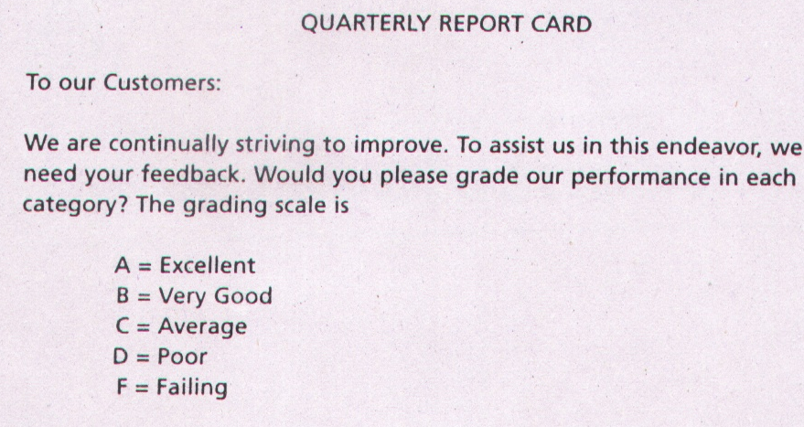
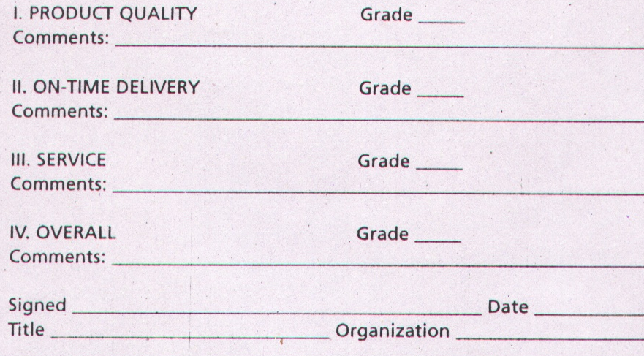

Slide 25
EMPLOYEES FEEDBACK
EMPLOYEES R UNTAPPED SOURCE OF INFORMATIONS
CONVENTIONALLY COMPANIES LISTEN MORE TO THE EXTERNAL CUSTOMERS & LESS TO THE INTERNAL CUSTOMER
EMPLOYEES USUALLY PROVIDE DEEPER INSIGHT INTO CONDITIOINS

Slide 26
EMPLOYEES FEEDBACK
CUSTOMERS RESAERCH REVEALS WHAT IS HAPPENING
EMLOYEES REASEARCH REVEALS WHY IT IS HAPPENING
IT SHOULD BE REGULARLY SOLICITED RATHER THAN CHECKING THE WOODEN BOX ANNUALLY

Slide 27
USING CUSTOMER COMPLAINTS
THE FEEDBACK OBTAINED IN ALL ABOVE CASES IS PROACTIVE
CUSTOMER COMPLAINT IS REACTIVE BUT VERY USEFUL
ASQ SURVEY REVEALS THAT ABOUT
1.5% COMPLAINTS REACH TOP MANAGEMENT
20% TO FRONT LINE PERSONNEL
80% DON’T REPORT

Slide 28
IT INDICATES THAT IT IS EASY FOR THE TOP MANGMNT TO PERCEIVE THAT EVERY THING IS OK
WHEN SATISFIED CUSTOMERS R INCLUDED IN THE DATA, NO. OF COMPLAINTS TO MANGMNT IS LOWER THAN 1.5%
FREQUENTLY DISSATISFIED CUSTOMERS DON’T SAY ANYTHING & QUIETLY SWITCH OVER TO COMPETITOR

Slide 29
THOSE WHO DONT COMPLAIN R THE ONE WHO SHOULD WORRY THE ORGANIZATION MOST
BY TAKING THE POSITIVE APPROACH TO THE COMPLAINTS IT IS POSSIBLE TO IMPROVE THE PRODUCTS/SERVICES
IN FACT COMPLAINTS GIVE THE ORGANIZATION A SECOND CHANCE

Slide 30
ONCE U HAVE IDENTIFIED THE COMPLAINTS/ PROBLEMS
NOW TURN TO ELIMINATION.
INCORPORATE CUSTOMER VOICE INTO PRODUCT/ SERVICE

Slide 31
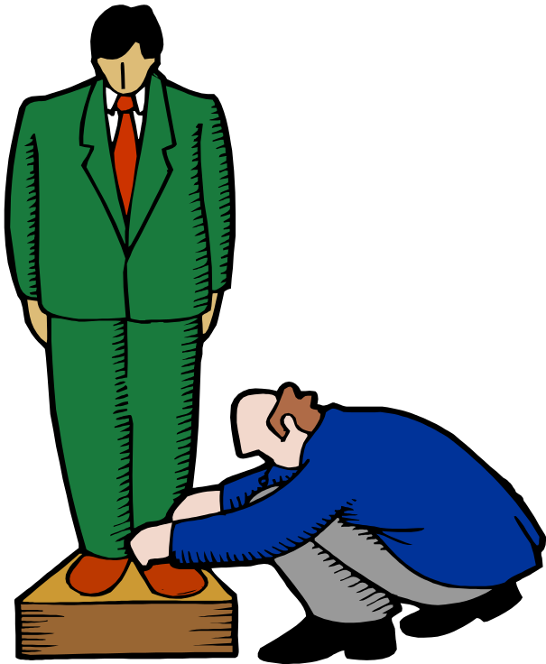
Mass Customization
GIVE CUSTOMER EXACTLY WHAT CUSTOMER WANTS

Slide 32
Mass customization
IN THE OUTSET, PRICE TAG ON SUCH PRODUCTS WAS PROHIBITIVE, BUT M.C PROVIDES THIS AT AFFORDABLE PRICE
M.C IS RESULT OF FLEXIBLE MANUFACTURING SYSTEM(FMS),JIT,& CYCLE TIME REDUCTION

Slide 33
Mass customization
IN AUTOMOBILES IT IS SINCE MANY YEARS
CUSTOMER MAY DETERMINE WHAT TYPE OF SEAT COVERINGS, COLOUR & STEREO SYSYTEM THEY WANT
COMPUTER MFRs & ASSEMBLERS DO IT

Slide 34
Mass customization
  Modular design
  Delayed differentiation

Slide 35
MODULAR DESIGN
Is a form of standardization in which component parts are subdivided into modules that are easily replaced or interchanged. It allows:
Easier diagnosis and remedy of failures
Easier repair and replacement
Simplification of manufacturing and assembly
DISADVANTAGE:
Variety Decreases

Slide 36

DELAYED DIFFERENTIATION
Delayed differentiation is a postponement tactic
Producing but not quite completing a product or service until customer preferences or specifications are known

Slide 37

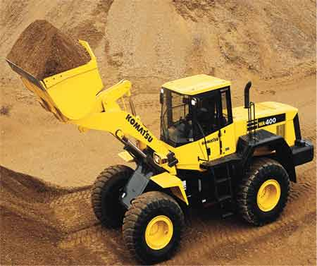
DELAYED DIFFERENTIATION

Slide 38
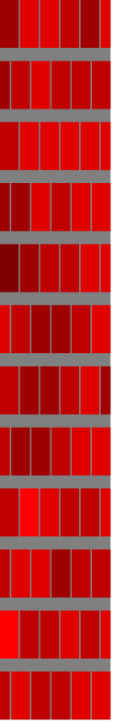

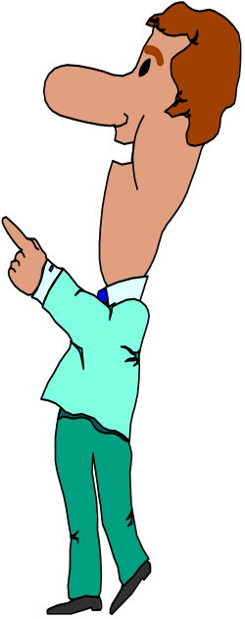

“Over the Wall” Approach
New
Product
Mfg
Design

Slide 39
CONCURRENT ENGINEERING
Concurrent engineering
is bringing together marketing, engineering, manufacturing, purchasing, service, packaging, etc. people early in the design phase.

Slide 40

ROBUST DESIGN
Design that results in products or services that can function over a broad range of conditions

Slide 41
CUSTOMERS’ REQUIREMENTS
NORMAL REQUIREMENTS Are typically what one gets by just asking customers what they want.
EXPECTED REQUIREMENTS Are the obvious / compulsory requirements. For example, if meal is served hot, customers barely notice it. If it's cold or too hot, dissatisfaction occurs. Expected requirements must be fulfilled.
EXCITING REQUIREMENTS
Beyond the customer's expectations.
If provided , customer would be excited
If not ,they would hardly complain

Slide 42
IN OTHER WORDS
NORMAL REQUIREMENTS
MORE IS BETTER
EXPECTED REQUIREMENTS
MUST BE
EXCITING REQUIREMENTS
DELIGHTENING,EXCITING, WOW FACTOR

Slide 43
KANOS MODEL
If the requirement is absent it does not cause dissatisfaction, but it will delight clients if present - "camera options"
Satisfaction
MORE IS BETTER
+
The more requirements are met the more one is satisfied
EXCITERS
Service Dysfunctions
Service Fully Functions
-
+
Must Be
Less satisfied when the product or service is less functional, but cannot increase satisfaction substantially if operational - "up-time"
-
Dissatisfaction

Slide 44
QUESTIONS?

